Slide 1
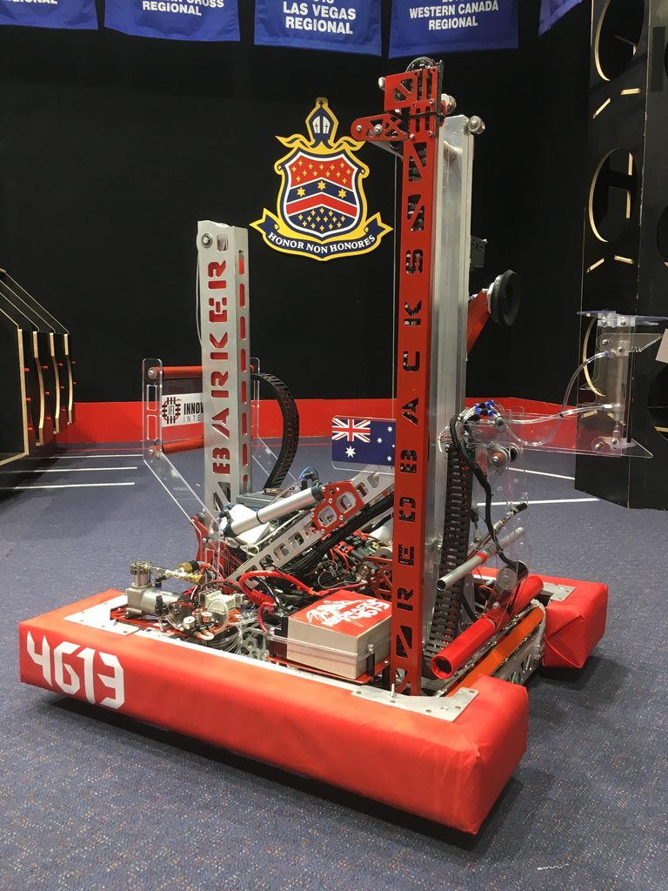

Datatypes and Variables
Overall Topic: Hardware
Basic Workshop 1.1

Slide 2

Introduction to variables
What is a variable?
A ‘box’
With a name
That stores a value
Of a specified type
Requirements for variable names:
Made up of upper- and lower-case letters, numbers and underscores
Do not start with a number
By convention use camelCase with a lower-case first letter
1
2
1
datatype variableName = value;
2
3
3

Slide 3

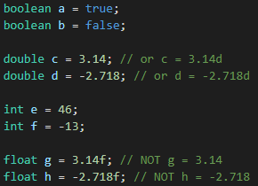
Primitive datatypes
All primitive types
Represent a single, simple piece of data
Begin with a lowercase letter
Datatype | Represents
boolean | A true or false value
double | A decimal number
int | An integer
float | A decimal number to less precision than a double

Slide 4
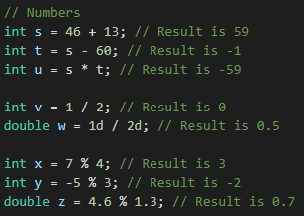
Numeric operations
Operations allow us to create new values from existing values.
Operator | Meaning | Results in
x + y | plus | The sum of x and y
x - y | minus | The difference between x and y
x * y | multiply | The product of x and y
x / y | divide | The result of dividing x by y, truncated to an int if both values are ints
x % y | modulo | The remainder when x is divided by y

Slide 5
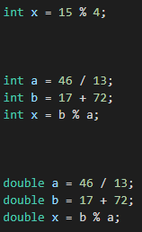

Numeric examples
What is the value of x in the following examples?
x is 3
What changes here?
a is 3
b is 89
x is 89 % 3 = 2
a is 3.538…
b is 89
x is 0.538…
a is 3 (why?)
b is 89
x is 2

Slide 6
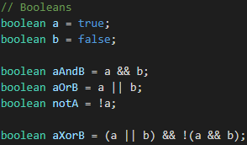
Boolean operations
We can also perform a different set of operations on boolean values.
Operator | Meaning | Is true if
x && y | and | Both x and y are true
x || y | or | At least one x and y is true
!x | not | x is false

Slide 7
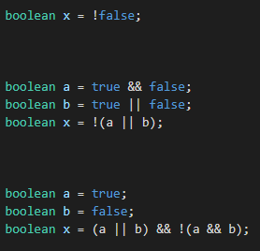
Boolean examples
What is the value of x in the following examples?
x is true
For what values of a and b is x true in example 3?
a is false
b is true
x is false
a | b | x
true | true | false
true | false | true
false | true | true
false | false | false
x is true

Slide 8
Complex datatypes
How are complex datatypes different to primitives?
Typically written in CapitalisedCamelCase
Can contain multiple pieces of data
Initialised by creating a new instance
Accept parameters in a constructor to determine their properties
1
2
1
Datatype variableName = new Datatype(parameters);
2

Slide 9
Hardware examples
Examples of objects that use complex datatypes:
Motors
TalonFX
TalonSRX
VictorSPX
Solenoids
Solenoid
DoubleSolenoid
Sensors
DigitalInput
AnalogInput
Typically a hardware part is represented in code as a single object that allows us to
Configure it on creation
Send instructions to it
Get information from it

Slide 10
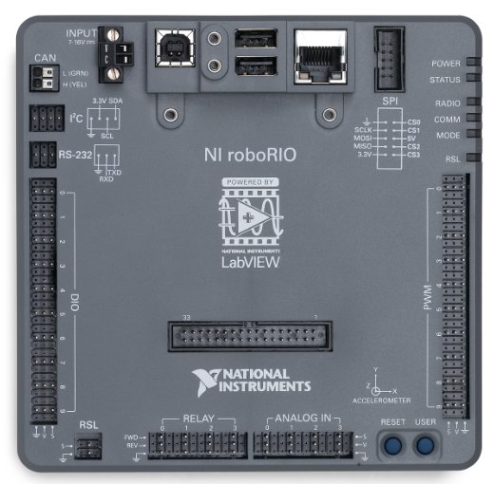
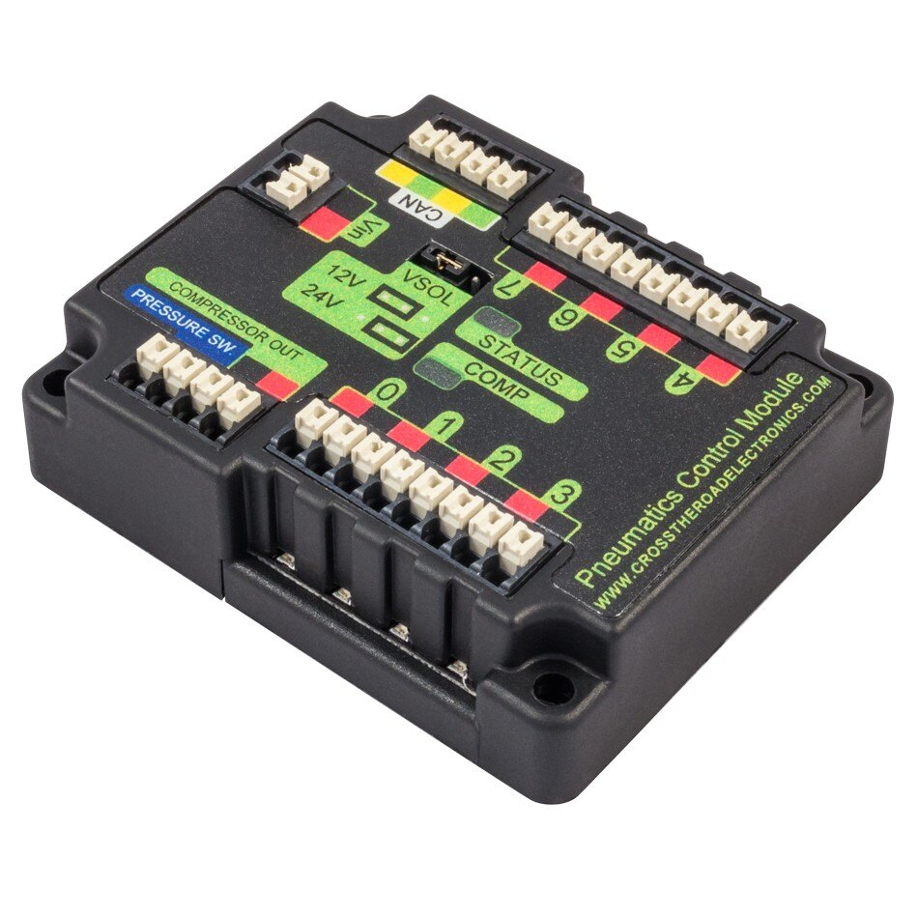
I/O ports
roboRIO
Pneumatics Control Module
CAN bus connection
CAN bus connection
Solenoid outputs
Digital inputs
PWM outputs
Analog inputs

Slide 11
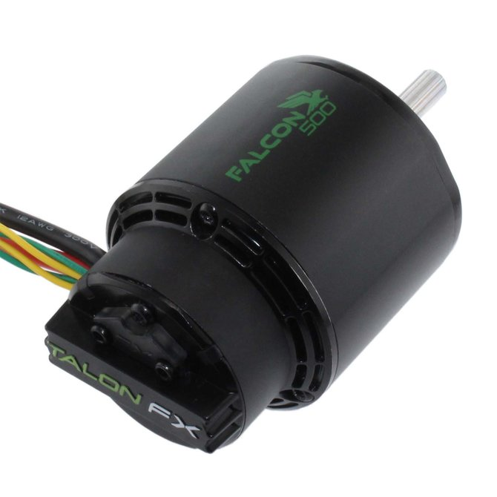

Falcon 500
Uses the TalonFX type
Is controlled via the CAN bus
Has an ID assigned via the CTRE Phoenix Tuner
Can be told to
Move at a set percentage of power output
Move at a set velocity
Follow another motor
Gives access to how fast/far it has moved

Slide 12
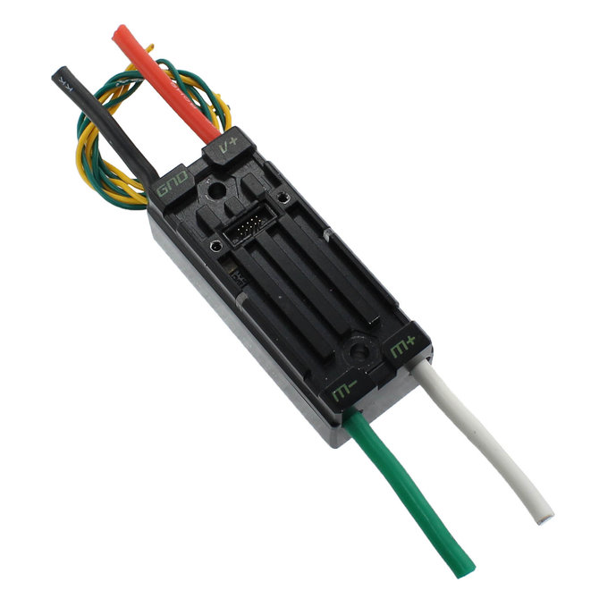
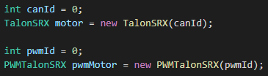
Talon SRX
Uses the TalonSRX type
Is controlled via the CAN bus
Has an ID assigned via the CTRE Phoenix Tuner
Can do what a Talon FX can, but needs a motor and encoder attached separately
Can also be plugged into PWM ports on the roboRIO

Slide 13
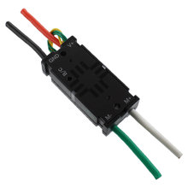
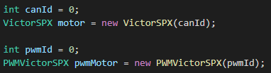
Victor SPX
Uses the VictorSPX type
Uses CAN or PWM
Like a Talon SRX without the ability to plug in an encoder

Slide 14
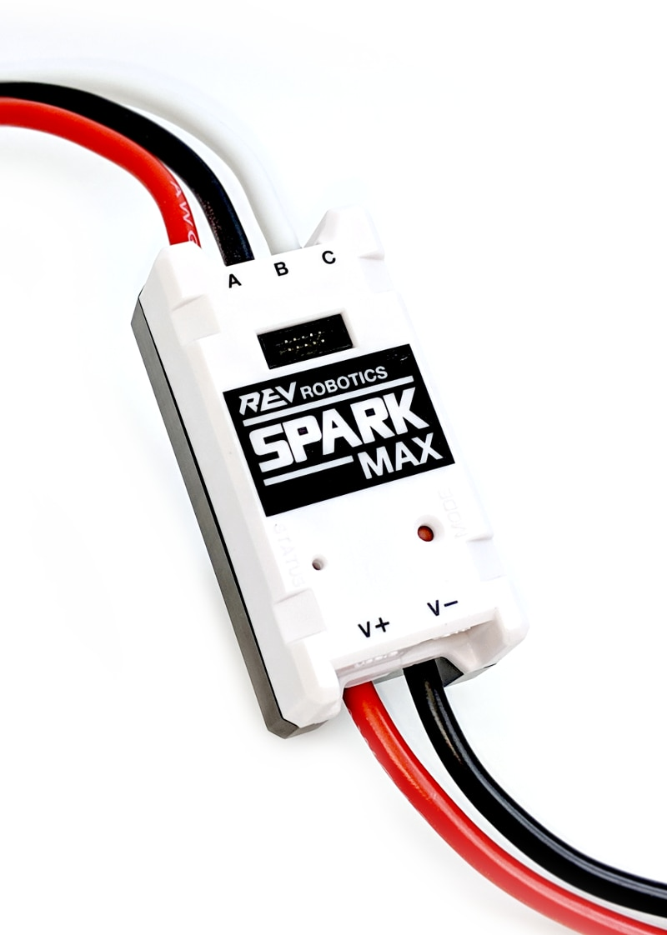
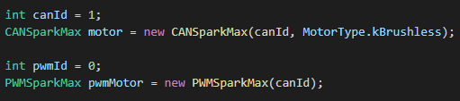
SPARK MAX
Uses the CANSparkMax type
Is controlled via the CAN bus
Has an ID assigned via the SPARK MAX client
Can also be plugged into PWM ports on the roboRIO
Typically used to control a Rev NEO motor

Slide 15
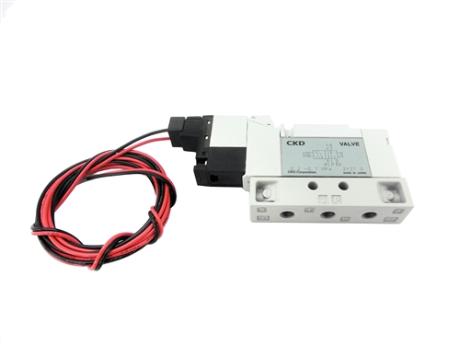
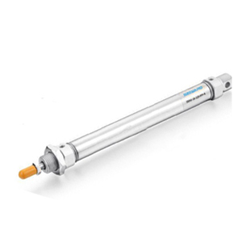

Single solenoid
Uses the Solenoid type
Is controlled via solenoid outputs on the PCM
Can be told to extend or retract
Only remains extended while powered

Slide 16
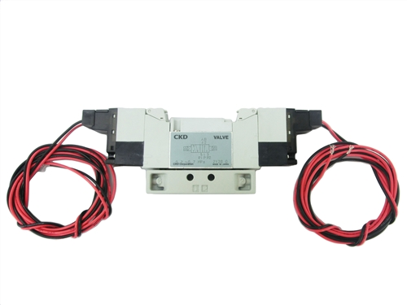

Double solenoid
Uses the DoubleSolenoid type
Is controlled via solenoid outputs on the PCM
Can be told to open the forward flow, open the reverse flow, or close
Closing allows it to remain in the same position when powered off

Slide 17
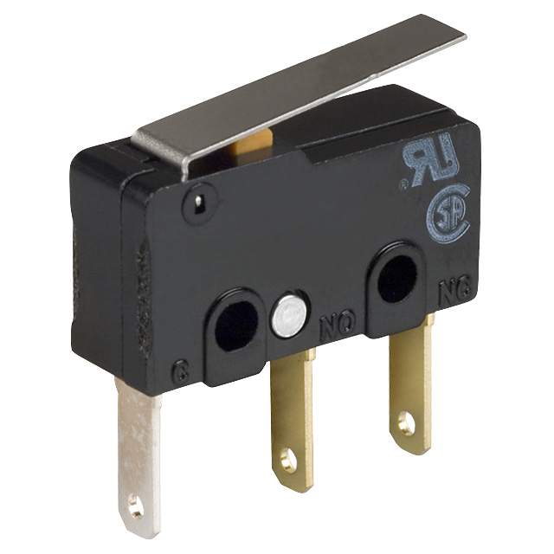
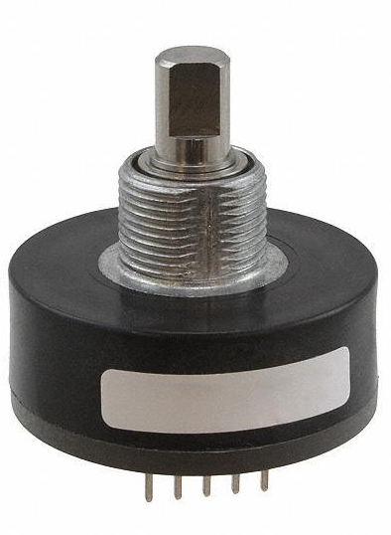
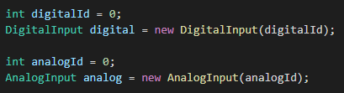
Digital and analog inputs
Plugged into the roboRIO or certain motor controllers
Give boolean or numeric values to represent their state

